Slide 1
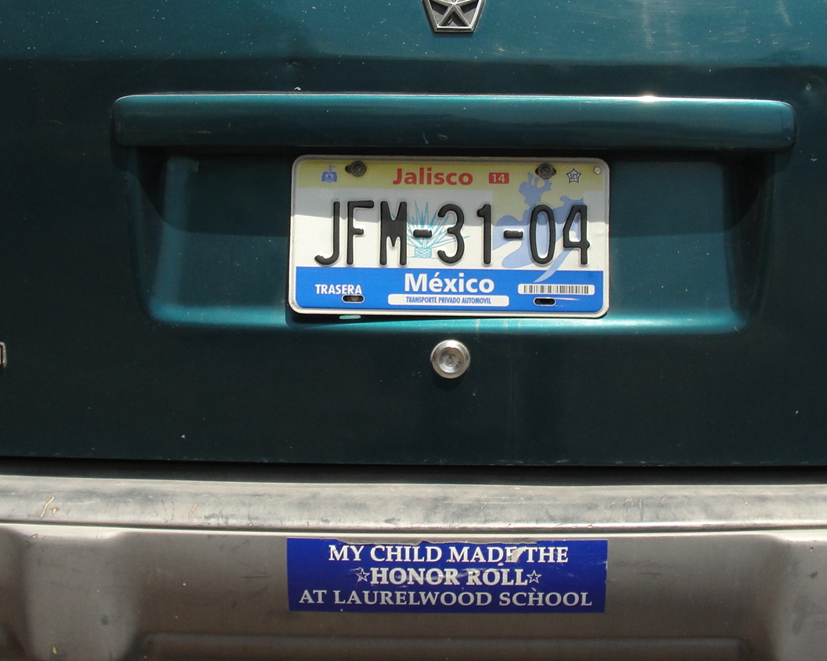
Identifying the Ethnographic in a Mixed Methods Study of Transnational Students in Mexican Schools Edmund ‘Ted’ Hamann, Víctor Zúñiga, & Juan Sánchez García
September 17, 2013 – Simposio Interamericano (UCLA)

Slide 2
Ten+ Years of Work

Slide 3
Return Migration to Mexico
De acuerdo a las autoras, la ENADID de 1992 permite estimar 180 mil migrantes retornados en los cinco años previos a la encuesta; la cifra va aumentando de la siguiente manera: 291 mil (según Conteo de Población y Vivienda 1995), 289 mil (ENADID 1997), 267 mil (Censo 2000), 344 mil (ENE 2002), 717 mil (ENADID 2007) y 994 mil (Censo 2010).
A lot of fascinating dynamics prospectively in play here:
Voluntary versus forced return
Transantionalism from below (Smith & Guarnizo, 1998)
Grandparent economic security strategizing (Dreby, 2010)
Of course we’re not just talking about ‘return’…U.S.-born children

Slide 4
Study Design: Four States
Durand and Massey’s four typologies
Nuevo León (2004): 173 schools (of 3310); 14,473 students (of 704,000)
Zacatecas (2005): 218 schools (of 4803); 9,217 students (of 282,000)
Puebla (2009-10): 214 schools (of 4,956); 18,829 students (of 966,000)
Jalisco (2010-11): 200 schools (of 7,787); 11,479 students (1,348,000)
Total: 805 schools; 53,998 students
Engaged in new work in Morelos and the zona metropólitana de Monterrey (ZMM) that I’m not planning on talking about.

Slide 5
Four states

Slide 6
Transnational Students in Mexican Schools
STATE | TRANSNATIONAL STUDENTS PROPORTION | NUMBER OF TRANSNATIONAL STUDENTS (estimated from our samples)
NUEVO LEÓN (2004/2005) | 1.6% | 11,000
ZACATECAS (2005/2006) | 2.4% | 7,500
PUEBLA (2009/2010) | 0.6% | 6,000
JALISCO (2010/2011) | 3.4% | 46,000
Total four states | 2.1% | 69,500
Estimated national | 1.9% | 420,000

Slide 7
Country of Birth
STATE | Sub-sample (4th-9th grades) | Percent born in Mexico | Percent born in the U.S. | Percent born in other country
NUEVO LEÓN (2004/2005) | 10,149 | 98.9% | 1.0% | 0.1%
ZACATECAS (2005/2006) | 7,619 | 98.2% | 1.8% | 0%
PUEBLA (2009/2010) | 12,025 | 99.1% | 0.8% | 0.1%
JALISCO (2010/2011) | 9,701 | 97.2% | 2.6% | 0.2%

Slide 8
U.S. Citizen Children (by birth) in Mexican Schools
STATE | Americans by birthplace
NUEVO LEÓN (2004/2005) | 7,000
ZACATECAS (2005/2006) | 5,100
PUEBLA (2009/2010) | 4,800
JALISCO (2010/2011) | 35,000
Total | 51,900
Estimated for the whole national school system | 330,000

Slide 9
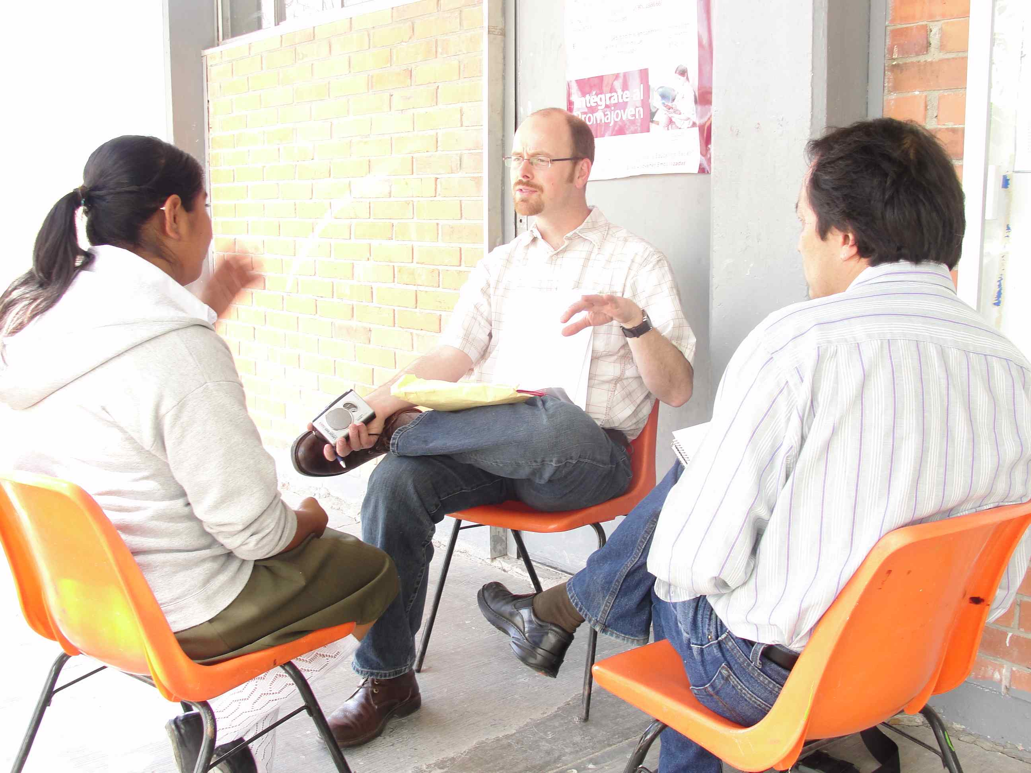
Imagining the work

Slide 10
Profile of Transnational Student (Cont.)

Slide 11
Pensamientos de una alumna
Is this ethnographic?
En: So far, speaking of the subjects you’re taking here, what subject is hardest?
--All of them besides English and little bit of math.
En: Are hard?
--the rest like Spanish and science and Formación Cívica y Ética. All of those Are hard.

Slide 12
Pensamientos de un alumno
From another interview
En: Pues pensando en las varias materias, ¿cuál es tu favorita?
--Química.
En: ¿cuáles otras materias?, ¿otras ciencias también?, ¿la Físíca o la Biología, o nada más la Química?
R: -Nada más la Química.
En: Ok. (…) ¿o hay maestro de Química aquí?
--No hay maestro de Química. En el libro trae experimentos, y de ahí los sacamos, incluso hoy vamos a hacer uno, y como no trajeron los demás el material, se va a hacer para mañana.

Slide 13
Table 1. Raw number of hits from various search terms (de las transcripciones de 29 entrevistas de alumnos transnacionales en Puebla realizado en 2010)
Is this ethnographic?
Word or word segment Number of total hits
Ciencia 8
Biología 3
Química 11
Físíca 1
Science 18
Biology 1
Chemistry 1
Matem- 41
Math 16
Tecn- 11
Compu- 45
Total 156

Slide 14
Deborah Reed-Danahy’s (2001) dilemma
There are things we want to know (about schooling) that only children can tell us
DRD noted in her study or rural French school-children that neither parents nor teachers fully knew the quotidian contexts that children negotiated
This is true experientially, not just cosmologically
Considering transnational students in Mexico the dilemma of limited adult knowledge about children’s worlds is more complicated and more acute
To gather information from this source requires accounting for the way students see the world

Slide 15
How might adult researchers misunderstand child informants…
Asking questions that a child does not understand because of vocabulary/concept/irrelevance
Ignoring what a child would have told you if the data gathering process had been more familiar/trustworthy/child-directed
Not recognizing a child’s intended emphases
Etc.

Slide 16
Catching / correcting at least some misunderstandings
Using mixed methods and then comparing data collected through different methods
Survey compared to in-person interviews
Surveys and our project’s inquiry about human variation
25 interviews of transnational students in Puebla Mexico who had previously responded to a written survey (of 85)
10 of these had at least one discrepancy that we discuss in the paper.
Interviews allow interviewer to respond to confusion or hesitation
Not mainly a reliability test (that would suggest flaws in the collected answers as opposed to the interpretations)

Slide 17
José Luis as an example
12 year-old in 1st year of secundaria
Born in Mexico. Had lived and gone to school in California from Kindergarten through Grade 4.
One of 10 students we discuss in our paper who differed at least once in how they answered a question on the survey versus during an interview
Four discrepancies in his responses on the survey versus during an interview

Slide 18
José Luís’ first discrepancy
In survey said he aspired to study at the university-level
But when we interviewed him he said he really was more interested in a vocational or technical training trajectory
University education was more his mother’s aspiration for him.
Offering what he thought he should say

Slide 19
José Luís’ Second Discrepancy
On survey he checked off the box that said his parents thought his education was important
But when we asked him about that point in the interview, he redirected the conversation to emphasize his sense that his teachers in California had been the ones with particularly high expectations
Our mental categories (as researchers) had led us to almost overlook that our question about parents’ perspectives may have given this relationship undue prominence in relation to the relations that JL thought were more salient.

Slide 20
José Luís’ Third Discrepancy
On the survey he indicated that he thought he ‘might’ (tal vez) return to study in the United States in the future.
In the interview, however, he took our question a different way, pointing out that he did not particularly care whether he continued his education in the U.S. or in Mexico, per se, but that he wanted to stay in one location or the other as the prospect of needing to build new friendships felt daunting.
Ours had been a question about probability and his response was in reference to desirability.

Slide 21
José Luís’ Fourth Discrepancy
He wrote in his survey, when asked to describe an example of when U.S. teachers had been good to him, that, “Good, my teachers there didn’t despise me although I was different” (“Bueno, por mi diferencia no me despreciaban”).
in his interview, he pointed out that he had liked his teachers in California because they had paid a lot attention to him and had “authentically cared” for him (Valenzuela, 1999: 61).
In a similar vein, on the survey he had mentioned that he thought that his parents felt his education was very important, but in the interview he expanded on this question not by talking further about his parents, but instead acknowledging his California teachers’ recognition that his education was important to them.

Slide 22
Types of discrepancies
Confusion
Elaboration
Confidence (in interviewer)
Remembering
Cosmology
Conclusion: Anthropological methodologies and orientations to acknowledge what is missing; what is distorted; what can be adjusted for

Slide 23
Evaluative Validity
According to Maxwell’s (1992) taxonomy of validity in qualitative research, evaluative claims—the subjective judgments of the researcher are the most difficulty of the five types of validity to ground.
Descriptive validity, Interpretive validity, theoretical validity, generalizability, evaluative validity

Slide 24
Three cases
One of 100 most promising middle school students in Colorado (who was born in LA), but parents decide endless, exhausting work and little time for family is not a way to lead a life…So move to rural Puebla.
Brother and sister (2nd and 6th grade) who were born in Chicago are sent by parents (who stay in US) to live with grandparents in rural Puebla, because parents worry about ICE enforcement separating them from their children.

Slide 25
America Promising Schooling as a Right and Vehicle of Social Mobility and Well-being
This paper attempts to ground the evaluative comment that “These three cases of Mexican-descent U.S. citizens in Mexican schools indicate a failure of U.S. schools and the larger American society to offer the educational and social nurturing promised in important American legal and philosophical statements such as Brown v. Board (1954), Dewey (1902), Counts (1932), and Conant (1945).”

Slide 26
For example
Today, education is perhaps the most important function of state and local governments. Compulsory school attendance laws and the great expenditures for education both demonstrate our recognition of the importance of education to our democratic society. It is required in the performance of our most basic public responsibilities…It is the very foundation of good citizenship. Today it is the principal instrument in awakening the child to cultural values, in preparing him for later professional training, and in helping him to adjust normally to his environment.

Slide 27
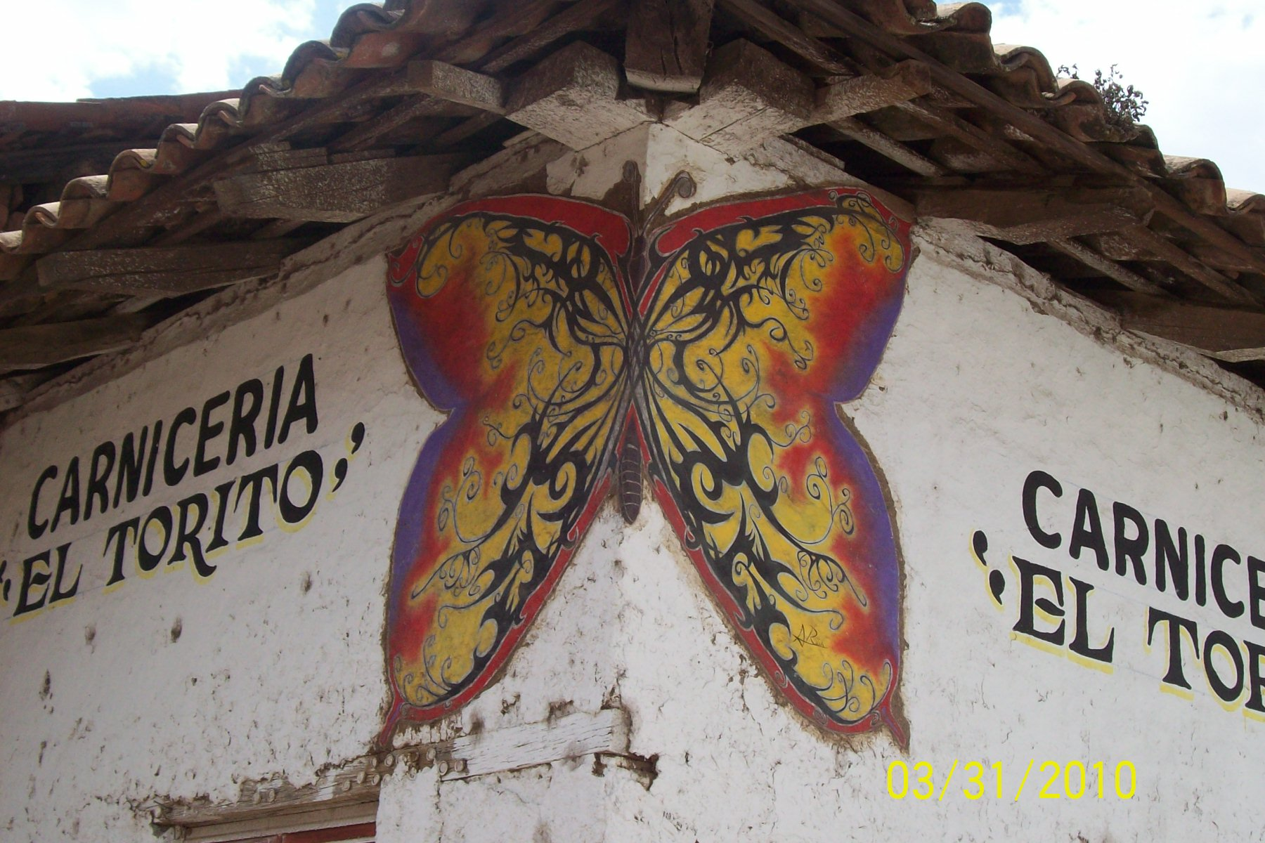
Pensando en la Migración

Slide 28
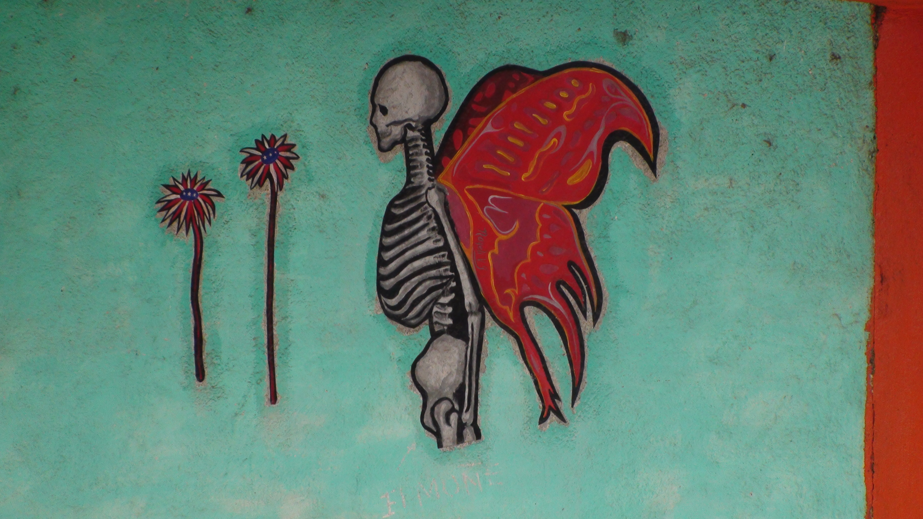
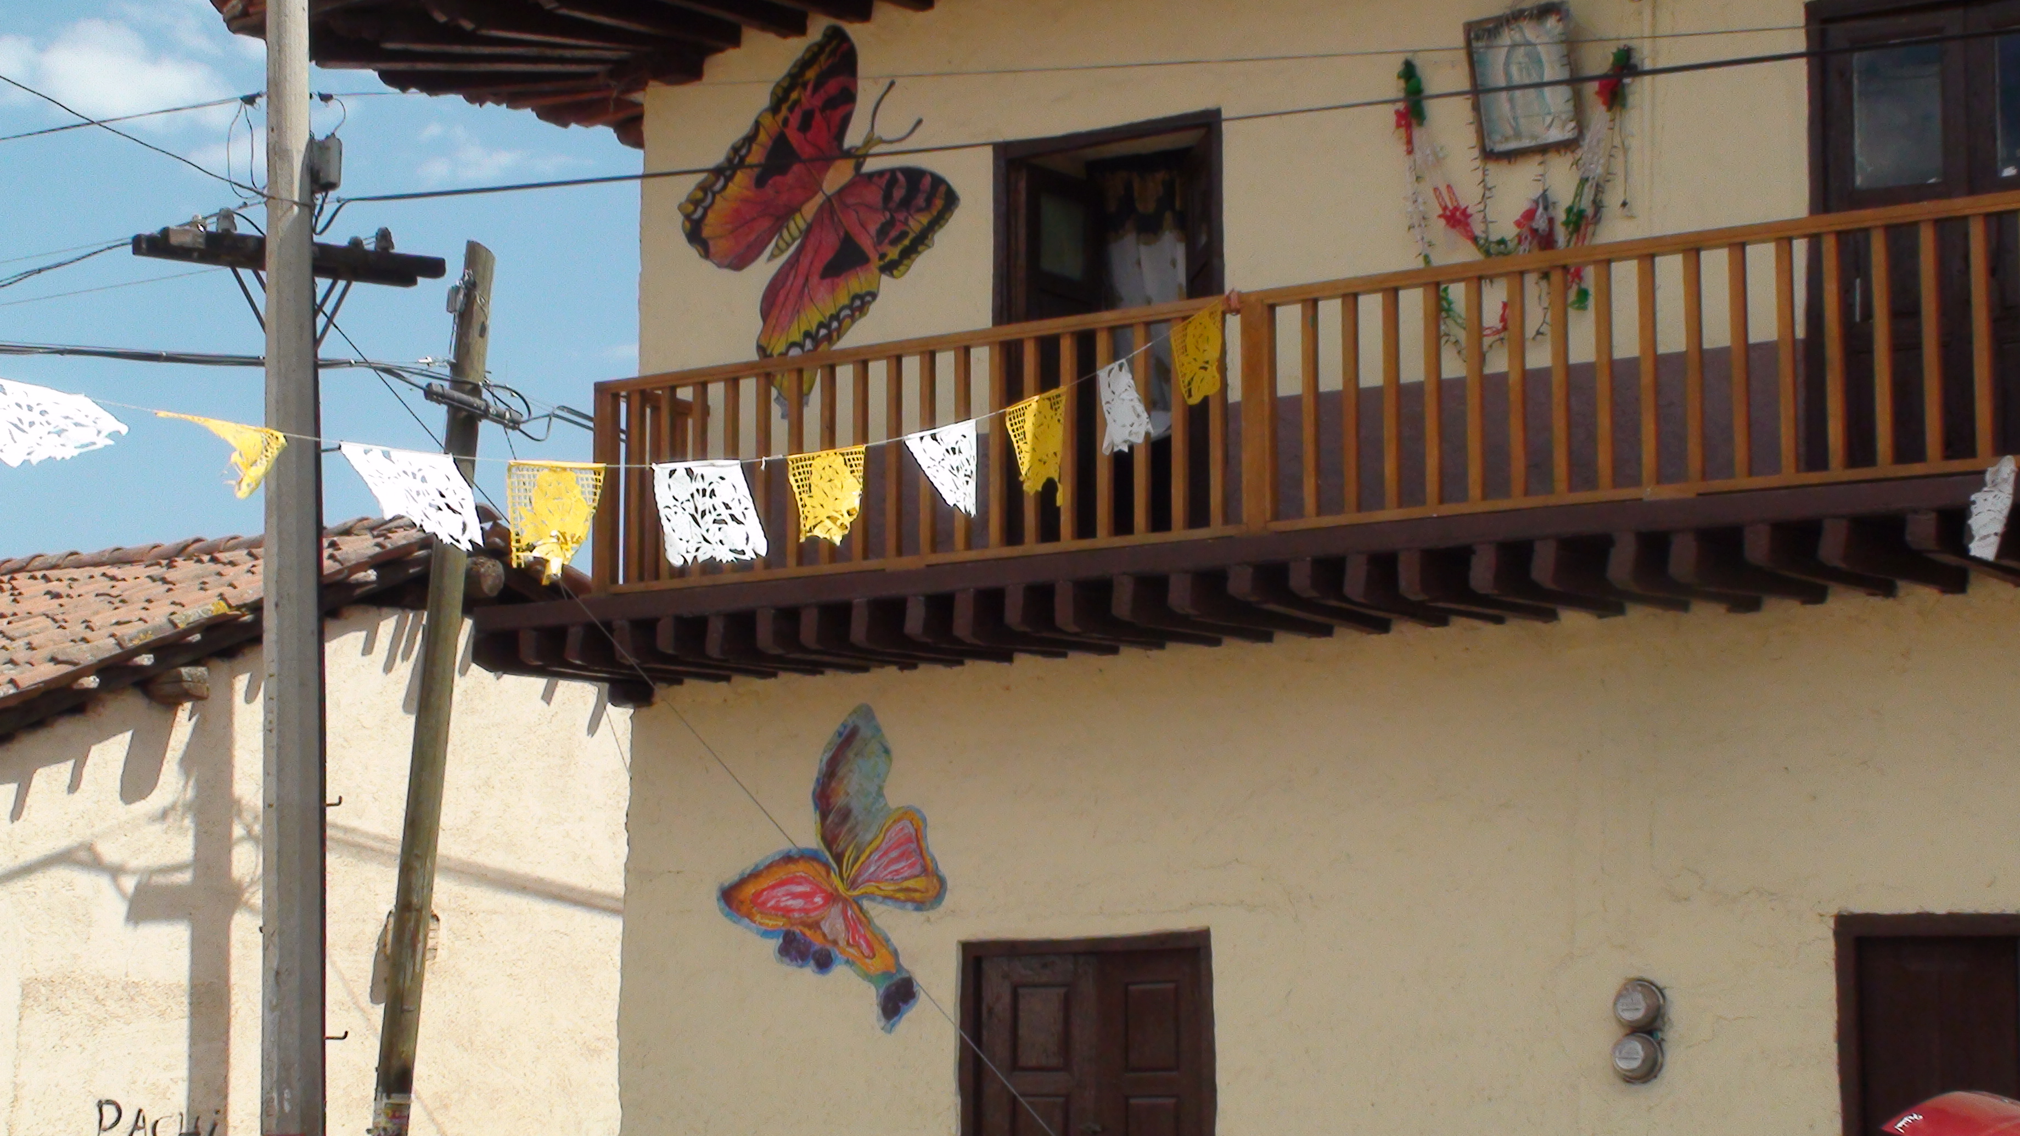
Pensando en la Migración

Slide 29
Pensando en la Migración

Slide 30
Access to Some of our work - 1
Hamann, E.T. & England, W. (2011). Hyphenated Identities as a Challenge to Nation-State School Practice? In S. Vandeyar (Ed.), Hyphenated Selves: Construction, Negotiation and Mediation of Immigrant Identity Within Schools – Transnational Dialogues (pp. 205-213). Netherlands: Rozenburg. http://digitalcommons.unl.edu/teachlearnfacpub/109/
Hamann, E.T. & Zúñiga, V. (2011). Schooling, National Affinity(ies), and Transnational Students in Mexico. In S. Vandeyar (Ed.), Hyphenated Selves: Construction, Negotiation and Mediation of Immigrant Identity Within Schools – Transnational Dialogues (pp. 57-72). Netherlands: Rozenburg. http://digitalcommons.unl.edu/teachlearnfacpub/110/
Hamann, E.T. & Zúñiga, V. (2011). Schooling and the Everyday Ruptures Transnational Children Encounter in the United States and Mexico. In C. Coe, R. Reynolds, D. Boehm, J.M. Hess, & H. Rae-Espinoza (Eds.), Everyday Ruptures: Children and Migration in Global Perspective (pp. 141-160). Nashville, TN: Vanderbilt University Press. http://digitalcommons.unl.edu/teachlearnfacpub/100/

Slide 31
Access to Some of our work - 2
Hamann, E. T., Zúñiga, V., & Sánchez García, J. (2006). Pensando en Cynthia y Su Hermana: Educational Implications of U.S./Mexico Transnationalism For Children. Journal of Latinos and Education 5(4): 253-274. http://digitalcommons.unl.edu/teachlearnfacpub/60/
Hamann, E.T., Zúñiga, V., & Sánchez García, J. (2010). Transnational Students' Perspectives on Schooling in the United States and Mexico: The Salience of School Experience and Country of Birth. In M. Ensor & E. Gozdziak (Eds.), Children and Migration: At the Crossroads of Resiliency and Vulnerability (pp. 230-252). New York: Palgrave Macmillan. http://digitalcommons.unl.edu/teachlearnfacpub/107
Zúñiga, V. & Hamann, E.T. (2009). Sojourners in Mexico with U.S. School Experience: A New Taxonomy for Transnational Students. Comparative Education Review. 53(3): 329-353. http://digitalcommons.unl.edu/teachlearnfacpub/91/

Slide 32
Access to Some of our work - 3
Zúñiga, V., & Hamann, E. T., (2008). Escuelas nacionales, alumnos transnacionales: La migración México/Estados Unidos como fenómeno escolar. Estudios Sociológicos de El Colegio de Mexico XXVI (76): 65-85. http://digitalcommons.unl.edu/teachlearnfacpub/78
Zúñiga, V., Hamann, E. T., & Sánchez García, J. (2008). Alumnos transnacionales: Las escuelas mexicanas frente a la globalización. Mexico, DF: Secretaria de Educación Pública. http://digitalcommons.unl.edu/teachlearnfacpub/97

