Slide 1
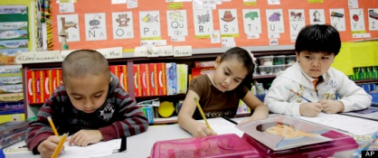
Dual-language immersion along the California-Mexico border: A Freirean approach
Dr. Richard Durán, UCSB (duran@education.ucsb.edu)
María José Aragón, UCSB (maragon@education.ucsb.edu)

Slide 2
Background
Research being conducted in collaboration with Dr. Cristina Alfaro and Alexandra Hunt at San Diego State University and Project Core.
School video first shared at a meeting on the development of the California ELD standards with teachers and education experts.
At this point research is exploratory; plans are to collect data during the 2013-2014 school year.

Slide 3
Objectives
Focus on instruction and its face-to-face implementation in a Freirean-based dual immersion (Spanish-English) school.
Students’ adoption of a shared vision of dialogic learning is examined by observing interactions among students and between students and teachers in three 4th grade classrooms.
We present an initial interactive sociolinguistic overview of how students negotiated peer editing of opinion texts as part of an ELA activity.

Slide 4
Methodology
Three 4th grade classrooms
Analysis of curriculum unit
Video and audio recordings
Classroom Observations
Interviews with teachers and administrators
Attendance at teacher planning meetings
Artifacts (student notebooks, assignment worksheets, classroom bulletin boards, etc.)

Slide 5
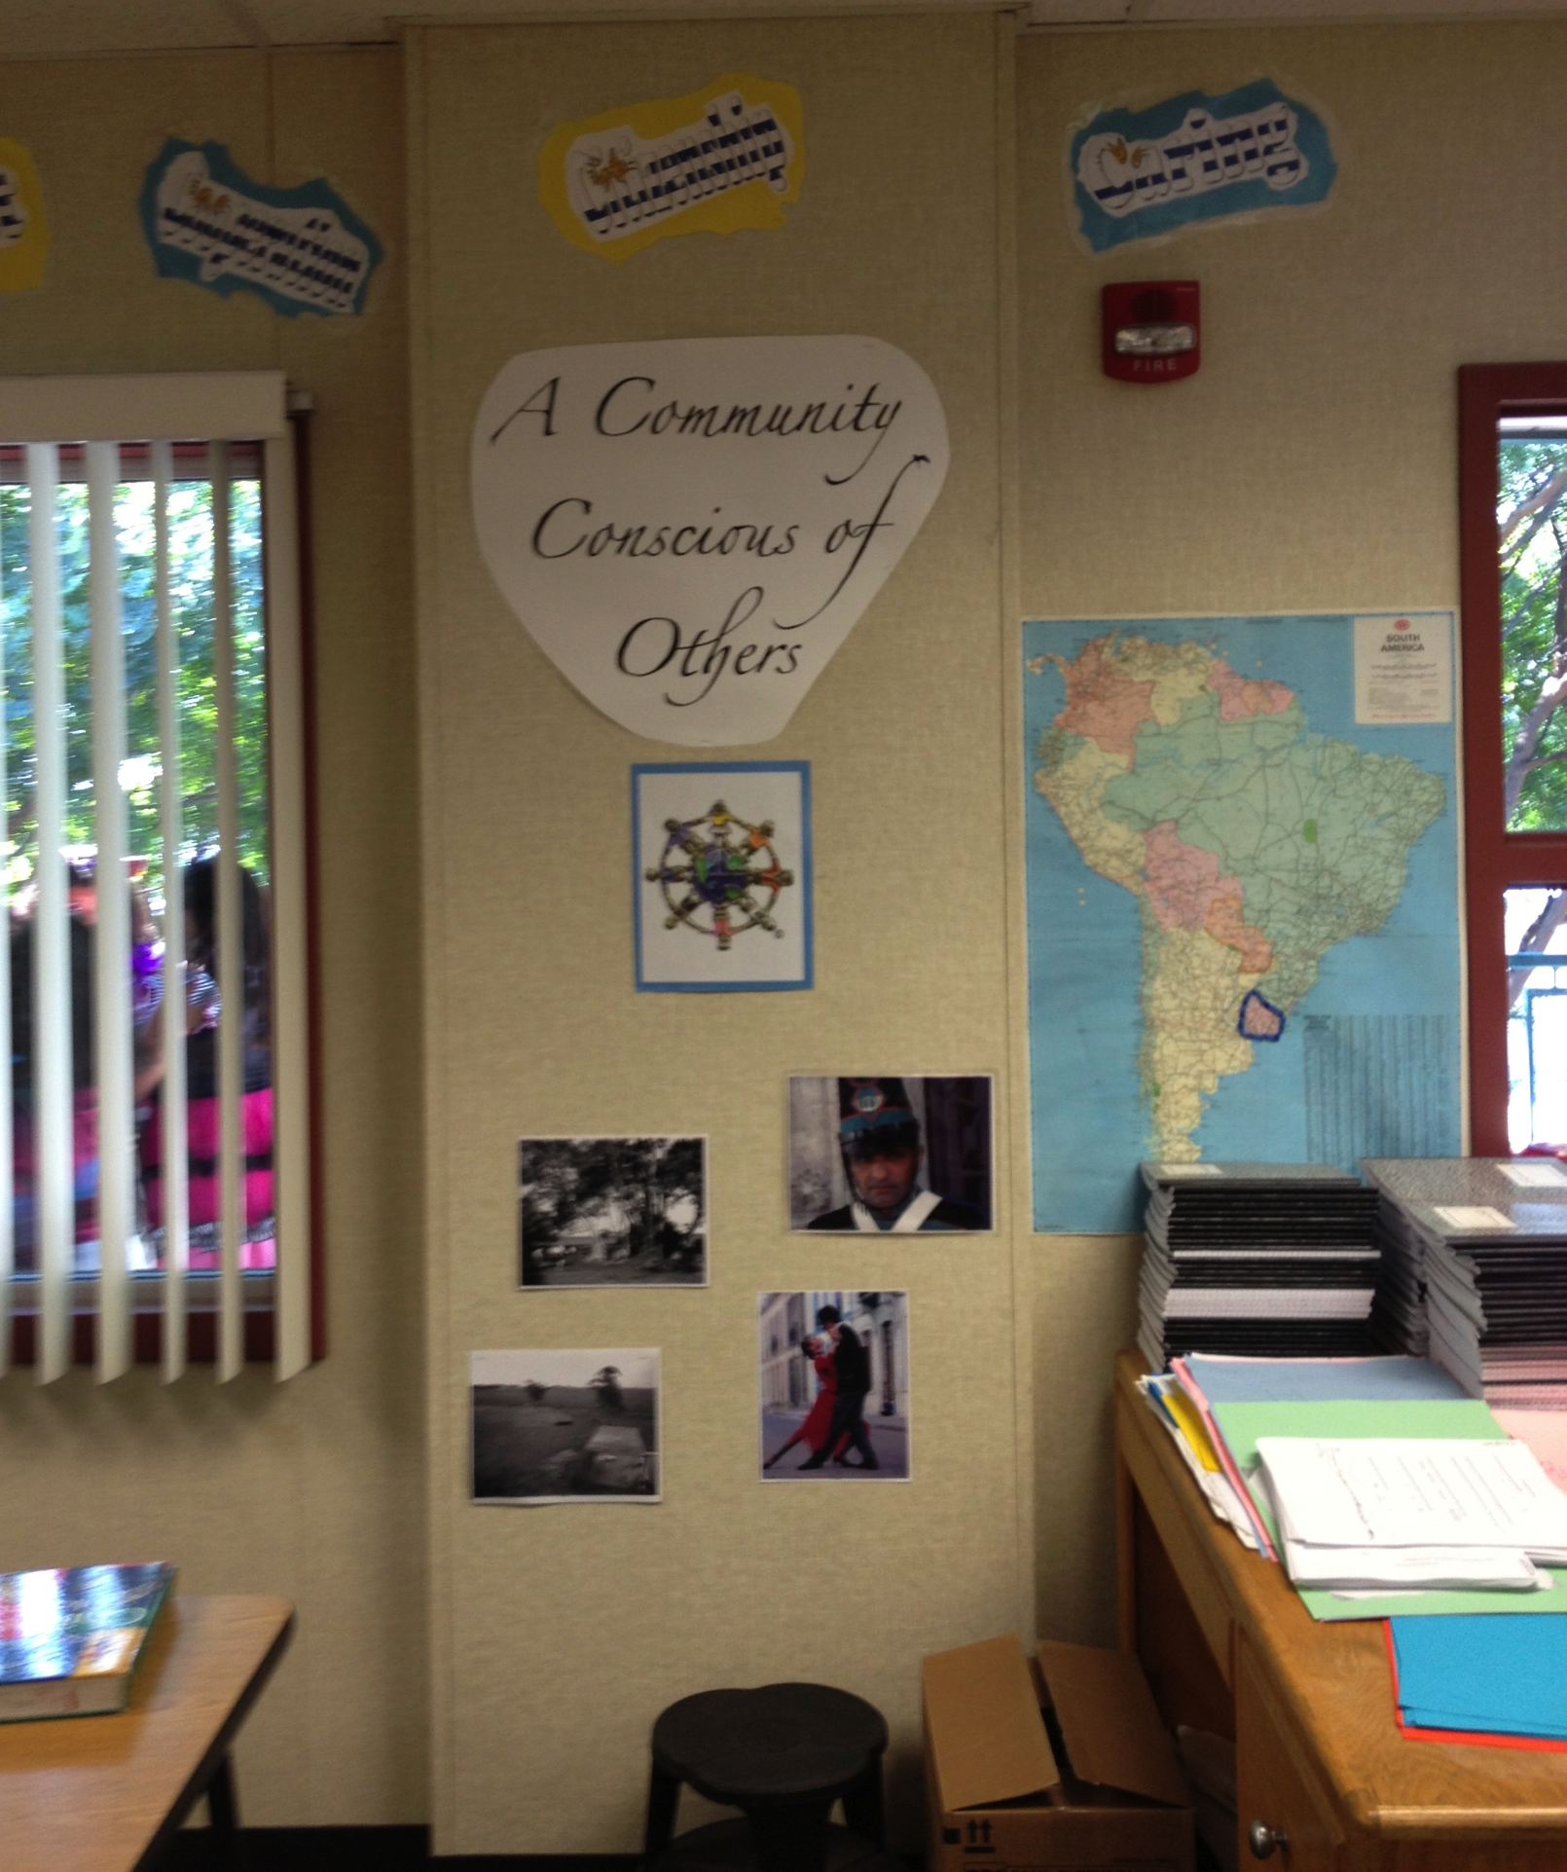
School Context
Chula Vista Learning Community Charter School (CVLCC)
Dual Immersion Spanish-English
Grades K-10
8 miles from U.S.-Mexico Border
95% Latino
53% English Learners
56% qualify for free and reduced lunch
California Distinguished School
Notes:
Chula Vista Community Charter School (CVLCC) is situated eight miles from the Mexico border, 95 percent of the student population at the K-8 school is Latino, with 53 percent English Learners and over half come from families that qualify for free and reduced lunch. CVLCC was performing so poorly that it made the federal watch list for three years. Today, the K-8 school has test scores among the highest in the district and has been recognized as a California Distinguished School. CVLCC was on the federal “program improvement” list until 2008, when it raised and sustained its Academic Performance Index scores from 680 in 2005 to 880 in 2012, exceeding the state goal of 800.

Slide 6
Curriculum
Freirean pedagogical approach
ELA, Math, Spanish
Emphasis on critical thinking skills across subject matter areas
Adoption of Common Core State Standards (CCSS)
Notes:
Can we insert an appropriate wall poster from our Oct 31, 2012 visit showing the grand design—cada quien forma su propia opinión…etc.?

Slide 7
Peer Editing Activity
4th grade English Language Arts class
Unit on historical global migration and immigration
Activity structure:
In your opinion, what was the best route for Forty-niners to migrate to CA during the Gold Rush of 1849?
In pairs, students outlined opinion essay based on evidence provided in an informational text.
Group dialogue based on peer-editing after essays were drafted and exchanged for written feedback.
Checklist and worksheets were used to scaffold peer dialogue.
Notes:
Essay Topic: In your opinion, what was the best route for Forty-niners to migrate to California during the Gold Rush of 1849?
Assignment was part of unit on migration and immigration
Students wrote an opinion piece based on evidence provided in an informational text
Video shows group dialogue based on peer-editing after essays were exchanged
Students used checklist and worksheets to scaffold dialogue and provide peer feedback by evaluating opinion, evidence, and explanation in each other’s essays

Slide 8
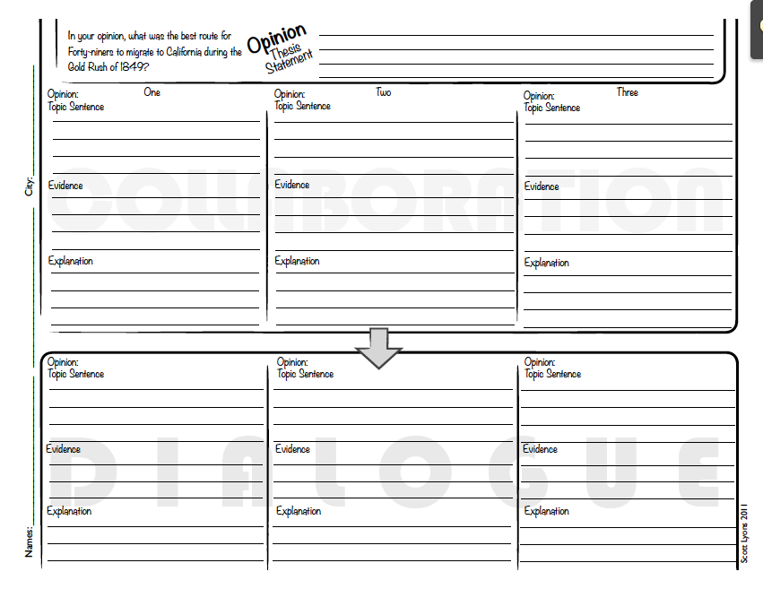

Slide 9
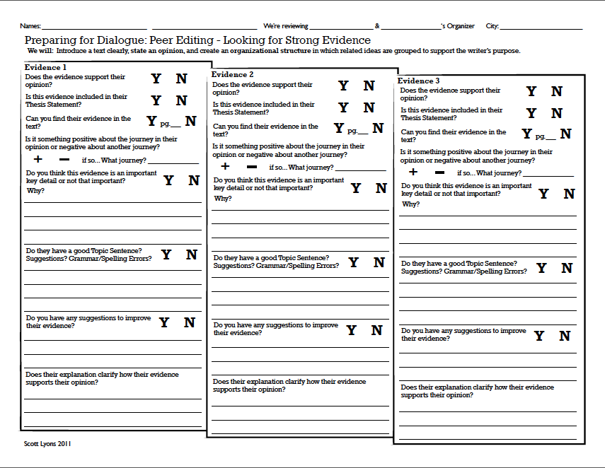

Slide 10
Video

Slide 11
Characteristics of Student Interactions
Critical thinking as a “genre”? (Bazerman, 2004; Collin, 2012)
Students’ use of “knowledge operators” (“evidence”, “thesis statement”, “topic sentence”, “opinion” etc.)
Material artifacts used to communicate and capture meaning (e.g. worksheets, bulletin boards)
Understanding of process (“So now…” “Let’s see if…”) dialogic thematic progression (Gumperz, 1982)
Shared ways of providing and receiving feedback (O’Connor and Michaels, 2007)
Blending of informal and academic language/registers Paralingusitic communication of meaning (Gumperz, 1982)
Individual differences in the way communicative acts are taken up and “performed” as life based on students’ identities and backgrounds (Bakhtin as interpreted by Kozulin, 1991)
Notes:
Critical thinking as a “genre”—understood as socially situated action and involving communicative practices (“schemas”) associated with texts and related material artifacts (Bazerman, Collin)
Students’ use of “knowledge operators” — high level analytic terms (“evidence”, “thesis statement”, “topic sentence”, “opinion” etc.)
Material artifacts used to communicate and capture meaning (e.g. worksheets, bulletin boards)
Understanding of process (“So now…” “Let’s see if…”) dialogic thematic progression (Gumperz)
Shared ways of providing and receiving feedback (O’Connor and Michaels)
Blending of informal and academic language/registers (ref Bahktin?)
Paralingusitic communication e.g. perlocutionary impact (Hymes)
Individual differences in the way persuasion is taken up and “performed” based on students’ identities and backgrounds (ref. Bakhtin and Kozulin)

Slide 12
Other Issues
Working with texts allows students to “envision different worlds” and share reasoning about them (Langer, 2011).
Can this form of dialogic learning be adapted to suit different language abilities and conversational styles?
In what ways can students be socialized to practice “critical thinking”?
How do students “animate” their “persona” as learners in the pursuit of learning objectives?

Slide 13
Key Practices “corresponding” to the CCSS
The activities and their analytic practices in the video “correspond” to a number of Common Core State standards:
List Standards also speaking and listening
Reading: Informational Texts
ELA-Literacy.RI.4.1 Refer to details and examples in a text when explaining what the text says explicitly and when drawing inferences from the text.
ELA-Literacy.RI.4.2 Determine the main idea of a text and explain how it is supported by key details; summarize the text.
ELA-Literacy.RI.4.8 Explain how an author uses reasons and evidence to support particular points in a text.
Writing
ELA-Literacy.W.4.1 Write opinion pieces on topics or texts, supporting a point of view with reasons and information.
ELA-Literacy.W.4.1b Provide reasons that are supported by facts and details.

Slide 14
Key Practices cont.
Speaking and Listening
ELA-Literacy.SL.4.1b Follow agreed-upon rules for discussions and carry out assigned roles.
ELA-Literacy.SL.4.1c Pose and respond to specific questions to clarify or follow up on information, and make comments that contribute to the discussion and link to the remarks of others.
ELA-Literacy.SL.4.1d Review the key ideas expressed and explain their own ideas and understanding in light of the discussion.

Slide 15
Standards in a Freirean framed classroom
CCSS, the CCSO ELD Standards Framework and next generation ELD Standards place more attention on ways that receptive and productive modalities can interact to support learning.
Can the analytical practices required of students be developed through a curriculum that also seeks to empower them and encourage them to think critically about the world?
To what extent is this way of “doing” persuasion compatible with these idionsyncratic form of expression and students’ identities as learners in bilingual and bicultural social contexts?

Slide 16
References
Bazerman, C. (2004). Speech acts, genres, and activity systems: How texts organize activity and people. In C. Bazerman & P. Prior (Eds.) What writing does and how it does it. An introduction to analyzing texts and textual practices. Mahwah NJ: Lawrence Erlbaum Associates.
Collin, R. (2012). Genre in discourse, discourse in genre: A new approach to the study of literate practice. Journal of Literacy Research, 44 (1), 76-96.
Gumperz, John J. (1982): Discourse Strategies. Cambridge: Cambridge University Press.
Langer, J. (2011). Envisioning knowledge: Building literacy in the academic disciplines. New York: Teachers College Press.
Kozulin, A. (1991). Life as authoring: The humanist tradition in Russian Psychology. New Ideas in Psychology. 9(3), 335-351.
O’Connor, C. & Michaels, S. (2007). When is dialogue ‘Dialogic’? Human Development 50, 275-285.

