Slide 1
FIRST TEACHING YEARS IN INDIGENOUS TELESECONDARIES. TEACHER EDUCATION EXPERIENCES
Etelvina Sandoval Flores
Universidad Pedagógica Nacional-México

Slide 2
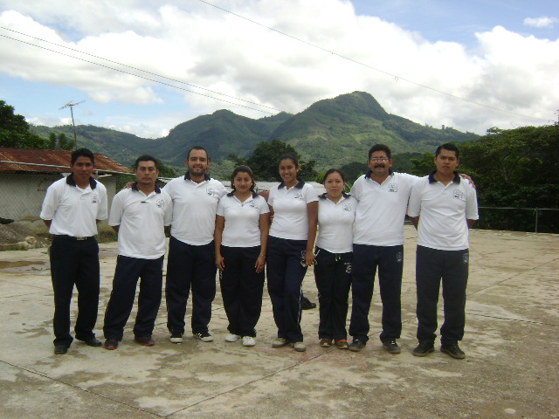
A SEP-SEB/ CONACYT research project entitled “The first teaching years. Practices and experiences in unfavorable contexts”.
Elementary and secondary school beginning teachers
Country and city schools,
both in unfavorable contexts
(Mexico City and Chiapas)
Reconstruction of their
teaching experiences
during their first years

Slide 3
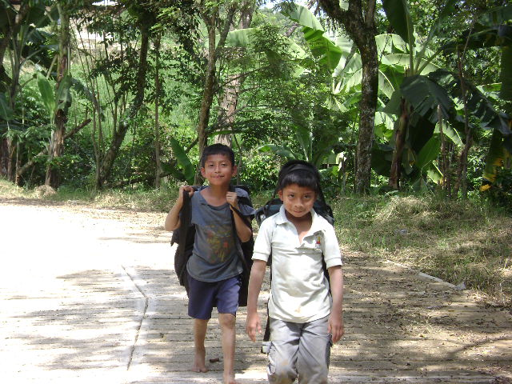
Teacher education in Mexico. A national policy
A task that legally corresponds to the State
Teacher education oriented homogeneously.
Teacher education changed
from a secondary level
to a tertiary one (in 1984).
Normal schools are the
teacher training schools
for Basic Education

Slide 4
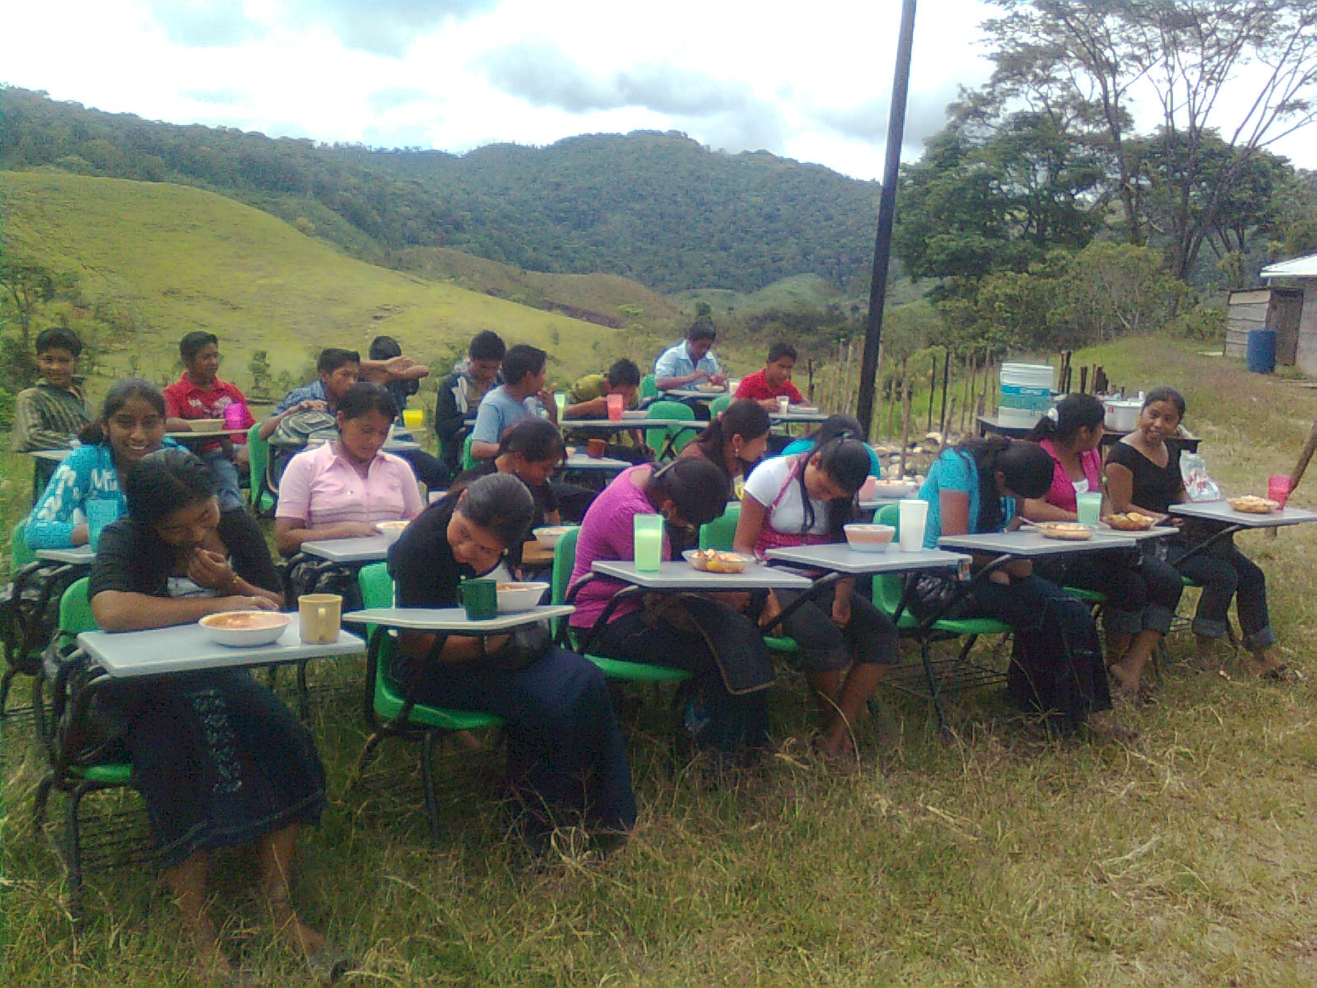
Telesecondaries

Slide 5
Telesecondaries
All subjects of the curriculum are taught by one single teacher with the aid of textbooks and TV programs. This is a “remedial” program
Currently, in our country 50% of secondary schools are telesecondaries
In Chiapas this percentage is higher (1286 out of 1886 secondary schools in this state are telesecondaries)

Slide 6
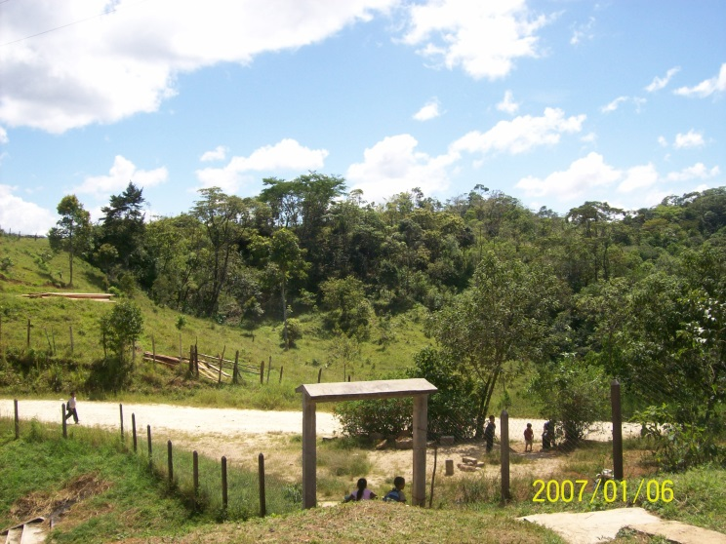
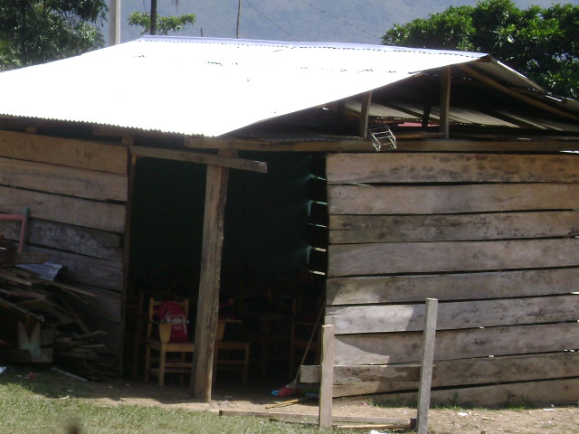
Beginning teaching
New teachers are sent to the
farthest, most isolated and
most marginal zones
They lack of resources
and aids for
their work

Slide 7
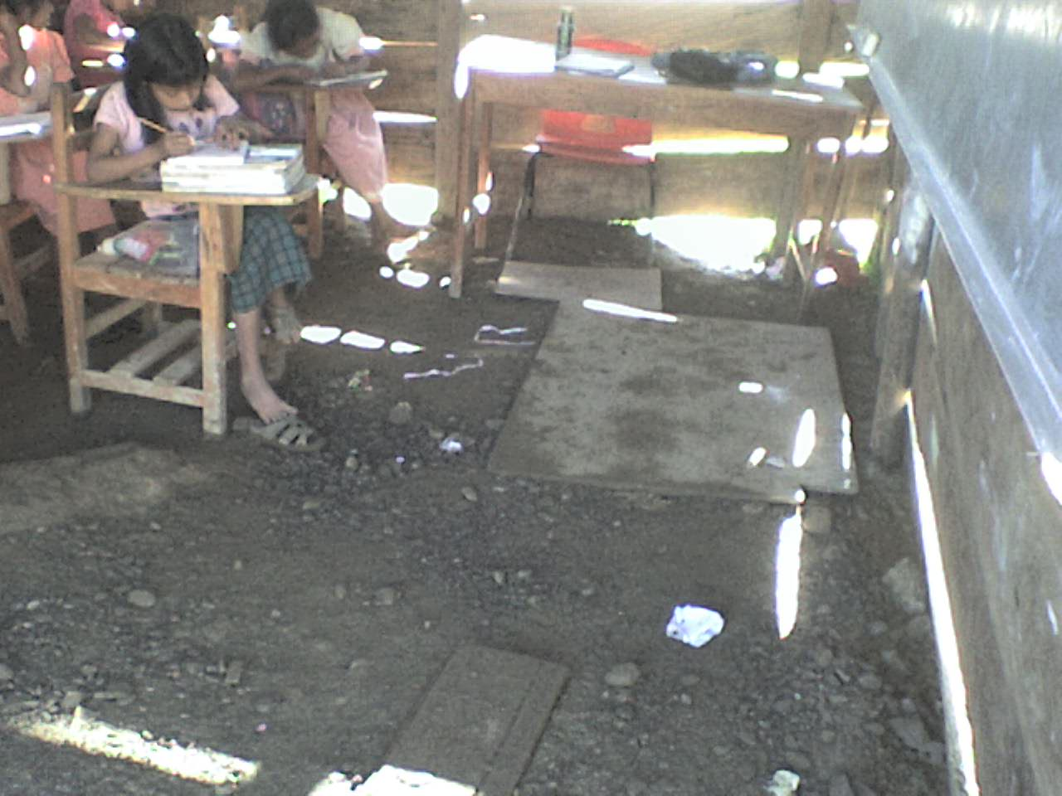
Beginning teaching
They have communication
problems
They live isolated
They experience
a cultural shock

Slide 8
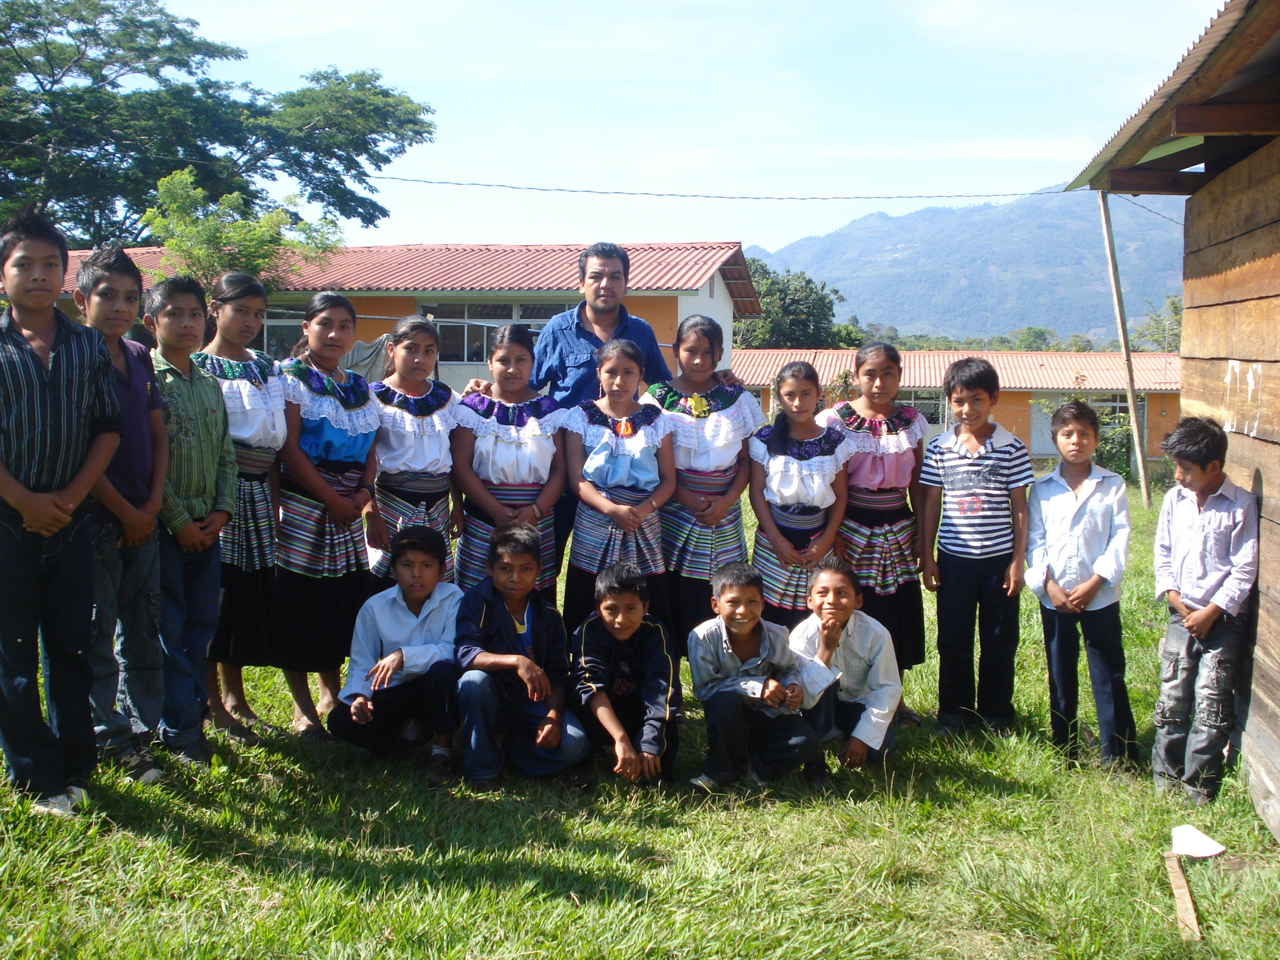
STORY OF IVAN

Slide 9
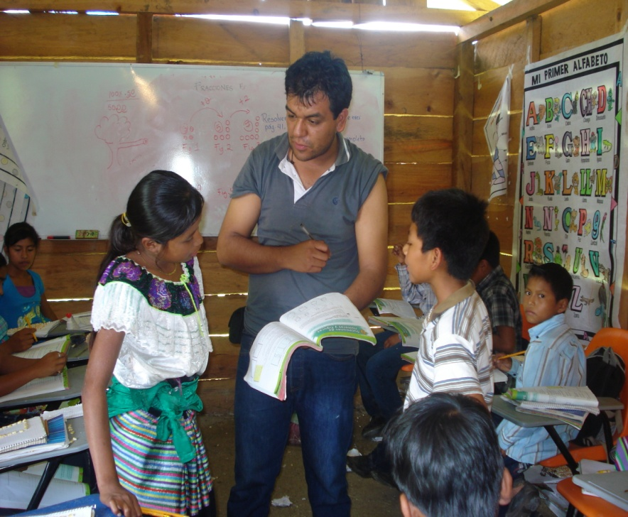
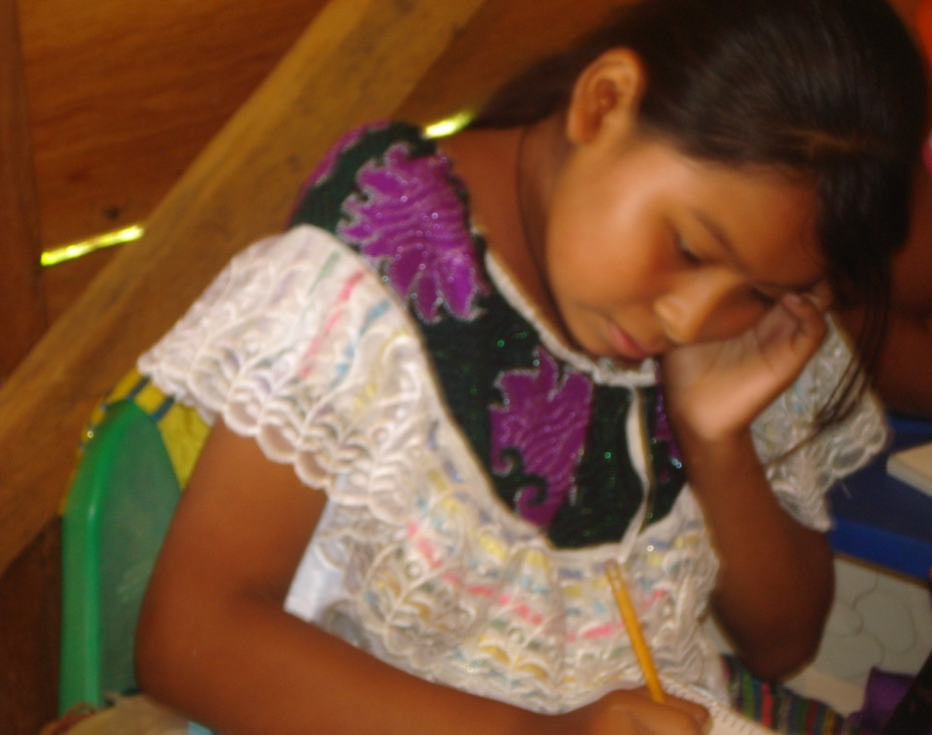
He learned the language with the help of one of his students
“Whenever I said a word in their language, they suddenly looked happier.”

Slide 10
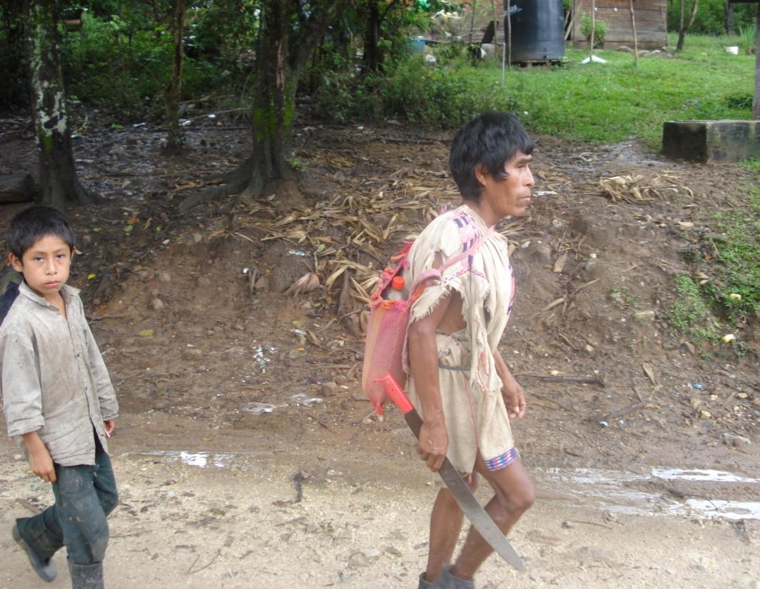
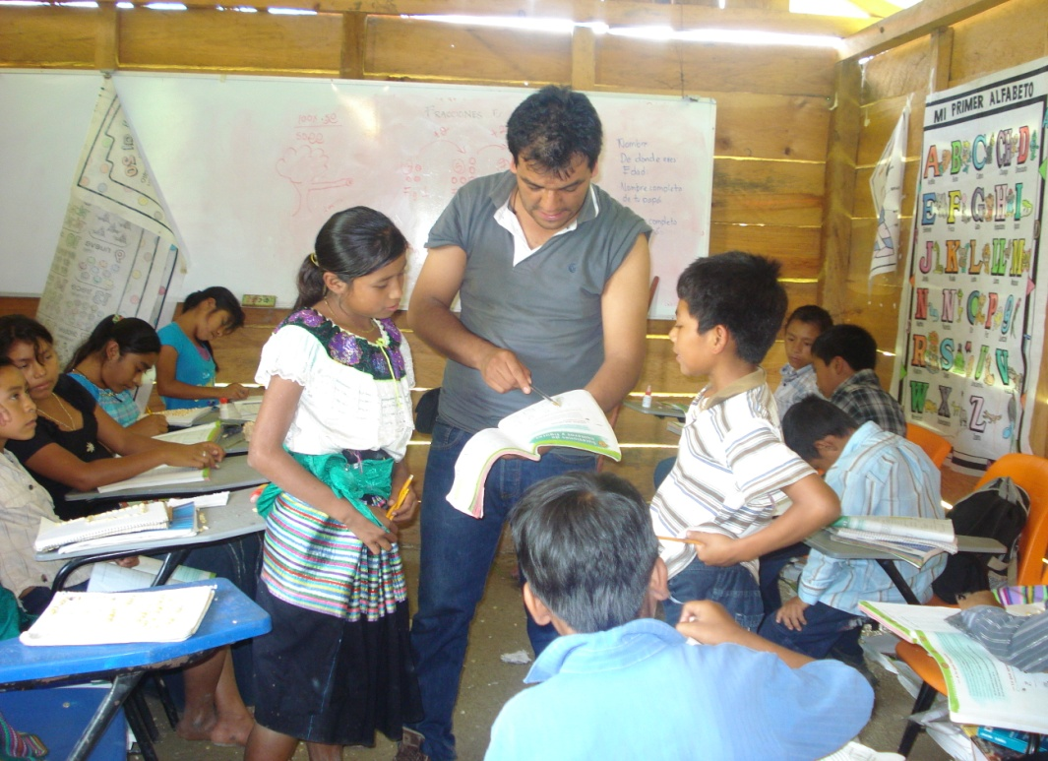
Understand cultural
backgrounds
Establish some dialogic
learning

Slide 11
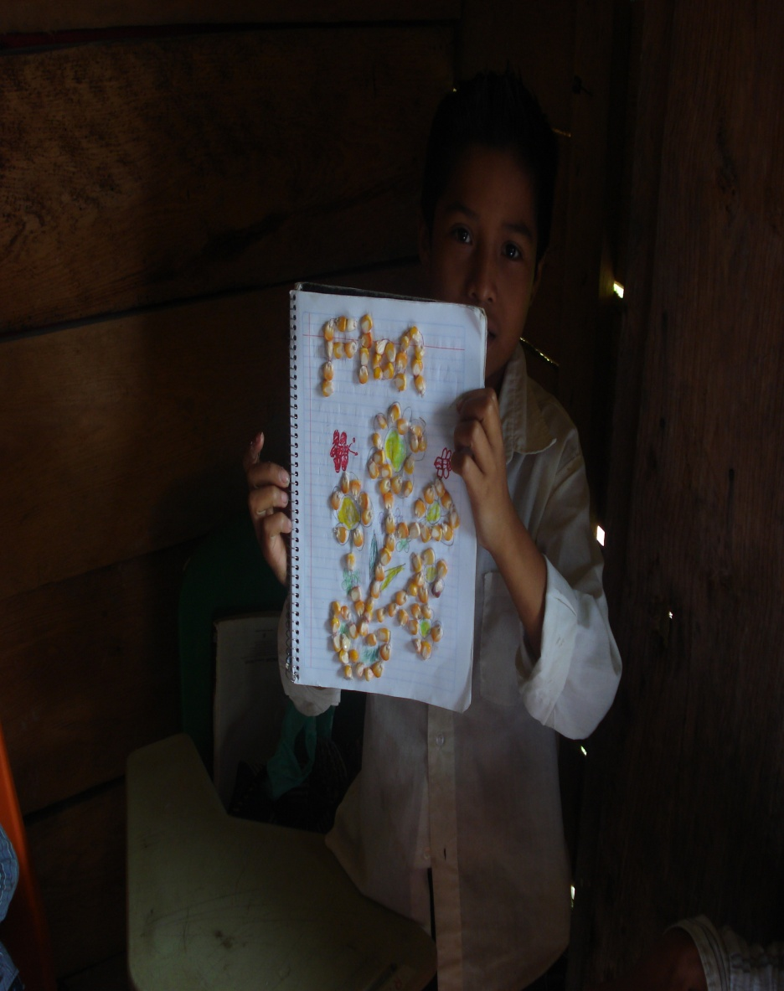
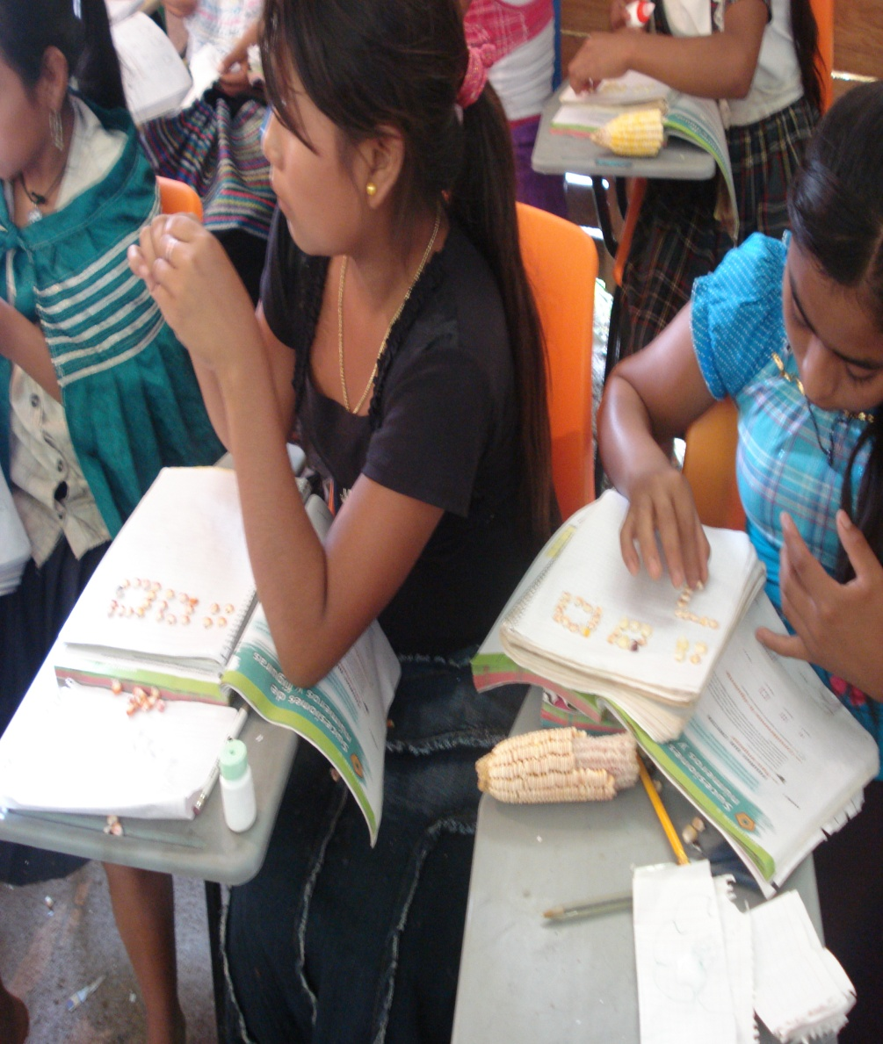
Teaching through cultural nodal points
Retrieval and internalización of local experiential knowledge

Slide 12
School experience: a source of teaching knowlegge
Beginning teachers identify who are “the others” and learn about their students, parents, and community. They also learn what is expected from their work as teachers.
They assume responsibility and develop skills to work under unfavorable conditions and without the essential teaching aids.
They have to teach unknown subjects or themes under unfamiliar conditions so they learn to teach diversely.
They come up with their own pedagogics derived from their very particular circumstances.

Slide 13
Some reflections
Review initial teacher education in the light of different social contexts.
Rethink models of mentoring for beginning teachers.
Collect the experience gained by these teachers as well as their pedagogic strategies implemented under unfavorable conditions. Here we can observe how these strategies and experience depict their school contexts and characteristics.

